Slide 1

The Future of SIEM
Team 9
Laxmi Dahal, Tanner Lyon, Asmayt Zeru, Dustin Hubrich, Micah Herndon
Notes:
Be sure to say the acronym

Slide 2

Agenda
Agenda
01
Legacy SIEM
Discuss history and development over the years
02
Use Cases and Threats
Needs for a SIEM and sophistication of threats
03
NG SIEM
New capabilities to address change in environments and limitations of Legacy
04
Recommendations
High Level recommendations to for SIEM models based on company size, needs and data sensitivity

Slide 3

Advanced analysis engines
Cloud based
Data from any source
Machine Learning
Automation
Horizontal Scaling
Larger Log sources with growth of networks
Better visuals and simple correlation/normalization
Vertical Scaling only
Simple Visuals
Pre-configured alerts
2017
History of SIEM
2011
2006
1996
Notes:
1st gen-– couldn’t handle large amounts of logs. Restricted to size of server. Only could increase cpu and other compute resources
2nd gen introduced horizontal scaling that helped grow the amount of logs stored and only there were beginning to be too many causing a bunch of false positive and it was still difficult to review historical logs because data as well because of the amount of logs provided but the lack of analysis and storage capabilities. Analysts were overwhelmed
NG --and some of what is currently out there– we are starting to see the ability to better manage false positives with preliminary investigations (automated triaging and prioritizing anomalies) being taken by machine learning tools. Things that can take behavior analysis to the user level, host based ids, and network based ids and make decisions for the analysit so they can focus on the real threats that require true mitigation and intervention from the analyst.

Slide 4

Use Cases
Access Control
Log Management
Compliance
Disparate Network And Data
IOT
Notes:
Access control – they need the ability to control access on a RBAC level and more granular at the ACL for individual files. Logging needs to occur to understand the current environment and know when activity is happening that is a possible threat. Things like making changes to program files outside of installations and updates. Users making changes to files they have access to based on their roles that they normally don’t mess with this. This addresses things like negligent and credential insider threats.
Log management is really addressing the idea of being able to classify and correlate data from different sources especially when dealing with tools in different environments and different vendors. It is hard to for analysts to have to make decisions of raw data that allows them to investigate.
Compliance stndards change as well as company policy. Companies need to be able to apply logic that ensures practices across the hybrid environment are remaining compliant to sensitive data standards and company policies
Going back to log management – this plays into that, networks are wide, far reaching, and they tend to create a hundreds of millions to billions of logs a day. How can an analyst be expected to properly and effectively parse and triage this data?
IoT provides a new world of endpoints that are vulnerable in nature and need special care to be monitored and managed

Slide 5
Threats
Enterprises - must distinguish clatter and real threats thus they need SIEM to see what is occurring
SIEM – best used for finding threats
Known and unknown threats
Machine learning and AI help detect/ identify suspicious activities and attacks
Setting up a sophisticated algorithms and automated rules of SIEM will help reduce false alarms and detect potential infractions for enterprises

Slide 6
Advanced Insider Threat
Advanced inside threat, Outside threat, and Advanced Persistent Threats
Advanced Inside Threat :
Machine learning algorithms and AI help detect threats with minimal clatter and identify high risk activities and quickly uncover serious incidents of alert to help enterprises focus on real threats.
Zero-Day and Unusual Networks are some of the insider threats that can go unnoticed by solutions since they do not have presently known network attack signatures.
Host-Based Security Solution: Firewall & anti-malware intend to solve the issue and detect the threat.
Notes:
APT

Slide 7
Disadvantages of Legacy SIEM
High Cost
Unable to analyze complex data
Legacy SIEM solutions are typically charged by amount of data or logs they store
Legacy SIEM are unable to incorporate non-IT information threat detection frameworks
Notes:
Source: https://www.securonix.com/seven-reasons-to-replace-your-legacy-siem-with-security-analytics-2/

Slide 8
Disadvantages of Legacy SIEM
Lacks scalability and flexibility
Event data has limited enrichment for additional context
Built on RDBMS (Relational database management system) or flat file database.
Data formats and structure are closed systems and don't allow flexibility for effective analysis.
Legacy SIEM don't add necessary relevant context for threat detection and incident response. Data is also limited to the IT technology that generated it. Example: OS log event will only have OS field and no additional context
Notes:
Source: https://www.securonix.com/seven-reasons-to-replace-your-legacy-siem-with-security-analytics-2/
Need for things like Data Lake store

Slide 9
Advantages of Next-Gen SIEM
More Predictable Cost
Handles Large
Amounts of Data
NG-SIEM services are charged with more predictable and cost-efficient pricing models, like number of users
NG-SIEMs are built on platforms that can sustain the analysis of large, complex data

Slide 10
Advantages of Next-Gen SIEM
Built on the Concept of Open Data
Data Has Context
NG-SIEMS can incorporate data from and share data to non-IT services using common data formats
NG-SIEMs store data with additional context, like IP address or user. This can be used to determine the priority of alerts

Slide 11
NG SIEM Flow
Detect and Apply Mitigation
Apply Analysis And Machine Learning
Takes preliminary steps to remove false positives, automate mitigation and workflow playbooks with SOAR, and stop threats
Aggregate and Normalize Data
Machine learning allows for user entity behavioral analysis (UEBA), indicate potential threats, classify unknown data (clustering)
Collect Log Sources
Able to transform data in a way that normalizes and provides relations
Capable of retrieving network and server log data from cloud and on-premise sources quickly and in real-time
Notes:
Micah—
Can also discuss the ability to cluster unknown data types by similarities in values for the data aggregation when discussing capabilities of NG SIEM
https://cdn2.hubspot.net/hubfs/4676441/NTA%20White%20Paper%20new-1.pdf – check this out to get a better idea of using things like Deep Packet Inspection agents to help with the supporting different analyses
Access control issues can be addressed by UEBA because itll be ble to configure and learn about users normal behaviors and alert when behaviors are different. For example User A typically makes changes to some source of data during the day but logs an event happening at 10pm in a weekend. Alert set in place. This can also apply to normal network and host based IDS behavior and information.

Slide 12
Integration into Hybrid Environments
On-site SIEM infrastructures risk obsolescence
Easy Integration
Compatibility of Cloud based SIEMs with other services
Provides extreme Flexibility to Organizations

Slide 13
Operational Improvement in Hybrid Environments
On-Site and Cloud Incident Response
Protection of Personal Data and meeting Compliance Requirements
Cloud native SIEMs use artificial intelligence to search through on-premise data centers, public clouds, and private clouds for threats and anomalies in different locations.
Organizations that have the responsibility to protect customers sensitive information like credit card or medical data are required to comply with certain security measures. By using a cloud based SIEM, you receive a reliable security intelligence that is easy to use and meets different compliance requirements for on-site and cloud data.
Variety of Data
Cloud native SIEMs can monitor log and event data from on-site data centers and clouds.

Slide 14
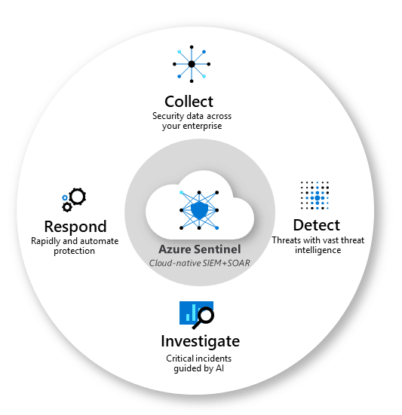
SIEM and SOAR
SOAR mean security, orchestration, automation response. It works with SIEM and allows security staff to teach it to gather pertinent data and take a certain course of action for different situations with automatic responses called incident response playbooks.
SOAR allows organizations to advance without increasing complexity.

Slide 15
Recommendations
Self-Managed
Third Party
 | Self-Hosted |  | Cloud Based
Smaller Company Low Data Sensitivity |  | Mid-Size Low-to-Mid Data Sensitivity
Large Experienced Company High Sensitivity |  | Low-level Analyst Experience Lower Upfront Costs High Data Sensitivity
Very Experienced Regardless of Size |  | Simple hybrid solutions Large Provider Tools Custom integrations
 | SIEM As a Service
Can be thought of as a cloud- based entity but helps provide more infrastructure for storage and processing power
 | Open Source
 | Enterprise
 | Custom

Slide 16
01
Legacy SIEM
Thank You
Questions?
02
Use Cases and Threats
03
NG SIEM
Questions?
04
Recommendations

